Slide 1
Inverted Index
Hongning Wang
CS@UVa

Slide 2
Abstraction of search engine architecture
Indexed corpus
Crawler
Ranking procedure
Feedback
Evaluation
Doc Analyzer
(Query)
Query Rep
User
Doc Representation
Ranker
Indexer
results
Index

Slide 3
What we have now
Documents have been
Crawled from Web
Tokenized/normalized
Represented as Bag-of-Words
Let’s do search!
Query: “information retrieval”
 | information | retrieval | retrieved | is | helpful | for | you | everyone
Doc1 | 1 | 1 | 0 | 1 | 1 | 1 | 0 | 1
Doc2 | 1 | 0 | 1 | 1 | 1 | 1 | 1 | 0

Slide 4
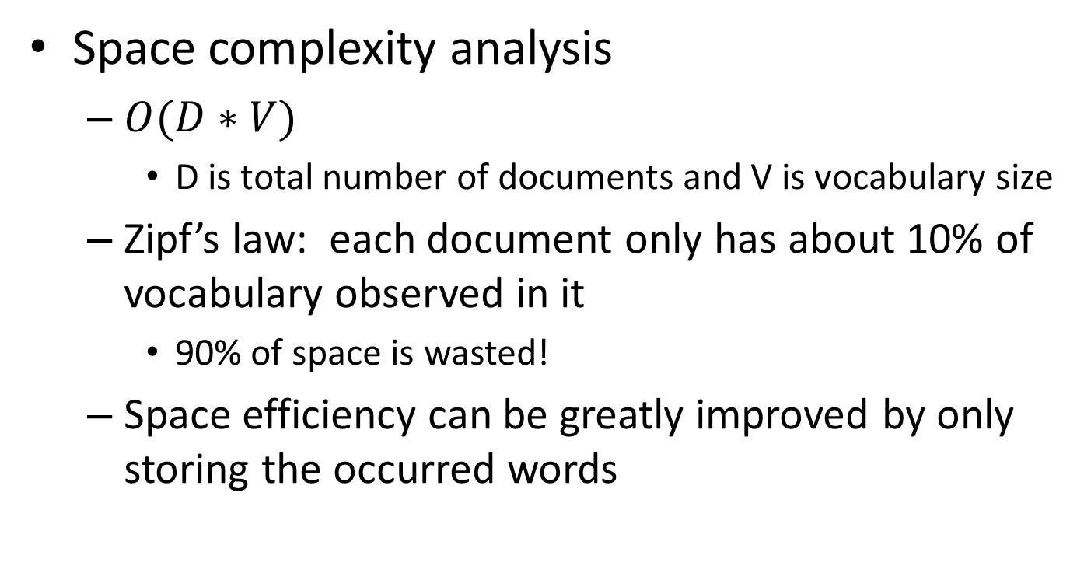
Complexity analysis
Space complexity analysis
$O(D∗V)$
D is total number of documents and V is vocabulary size
Zipf’s law: each document only has about 10% of vocabulary observed in it
90% of space is wasted!
Space efficiency can be greatly improved by only storing the occurred words
Solution: linked list for each document

Slide 5

Complexity analysis
Time complexity analysis
$O(\left|q\right|∗D∗|D|)$
$\left|q\right|$ is the length of query, $|D|$ is the length of a document
doclist = []
for (wi in q) {
for (d in D) {
for (wj in d) {
if (wi == wj) {
doclist += [d];
break;
}
}
}
}
return doclist;
Bottleneck, since most of them won’t match!

Slide 6
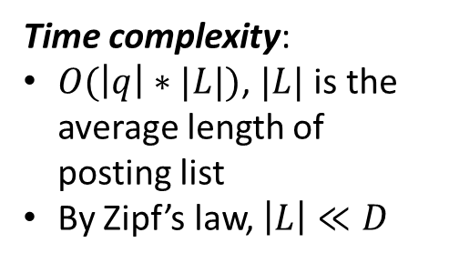
Solution: inverted index
Build a look-up table for each word in vocabulary
From word to find documents!
Dictionary
Postings
information
retrieval
retrieved
is
helpful
for
you
everyone
Doc1
Doc2
Time complexity:
$O(\left|q\right|∗|L|)$, $|L|$ is the average length of posting list
By Zipf’s law, $\left|L\right|≪D$
Doc1
Query:
information
retrieval
Doc2
Doc1
Doc2
Doc1
Doc2
Doc1
Doc2
Doc2
Doc1

Slide 7
Structures for inverted index
Dictionary: modest size
Needs fast random access
Stay in memory
Hash table, B-tree, trie, …
Postings: huge
Sequential access is expected
Stay on disk
Contain docID, term freq, term position, …
Compression is needed
“Key data structure underlying modern IR”
- Christopher D. Manning

Slide 8
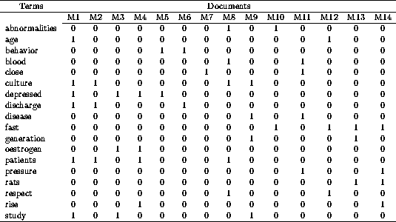
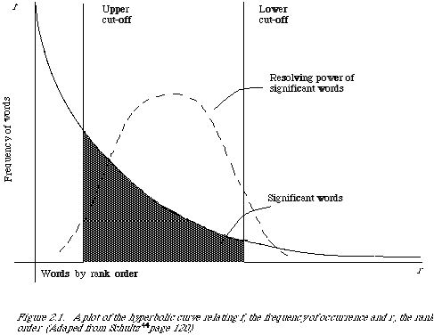
Recap: Zipf’s law
Remove non-informative words
Remove 1s
Remove 0s
Remove rare words

Slide 9
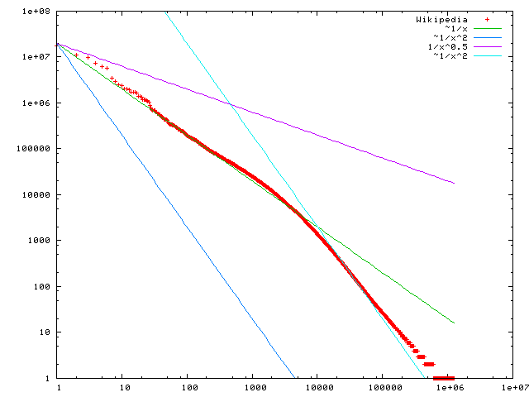
Statistical property of language
Word frequency
Zipf’s law
Frequency of any word is inversely proportional to its rank in the frequency table
Formally
$f\left(k;s,N\right)=\frac{1/k^{s}}{\sum_{n=1}^{N}{1/n^{s}}}$
where $k$ is rank of the word; $N$ is the vocabulary size; $s$ is language-specific parameter
discrete version of power law
Word rank by frequency
A plot of word frequency in Wikipedia (Nov 27, 2006)

Slide 10
Recap: Normalization
Solution
Rule-based
Delete periods and hyphens
All in lower case
Dictionary-based
Construct equivalent class
Car -> “automobile, vehicle”
Mobile phone -> “cellphone”
Stemming: Reduce inflected or derived words to their root form

Slide 11
Recap: crawling and document analyzing
Indexed corpus
Visiting strategy
Avoid duplicated visit
Re-visit policy
Crawler
HTML parsing
Tokenization
Stemming/normalization
Stopword/controlled vocabulary filter
Doc Analyzer
Doc Representation
BagOfWord representation!

Slide 12
Recap: inverted index
Build a look-up table for each word in vocabulary
From word to find documents!
Dictionary
Postings
information
retrieval
retrieved
is
helpful
for
you
everyone
Doc1
Doc2
Time complexity:
$O(\left|q\right|∗|L|)$, $|L|$ is the average length of posting list
By Zipf’s law, $\left|L\right|≪D$
Doc1
Query:
information
retrieval
Doc2
Doc1
Doc2
Doc1
Doc2
Doc1
Doc2
Doc2
Doc1

Slide 13
Sorting-based inverted index construction
<Tuple>: <termID, docID, count>
Sort by docId
Sort by termId
All info about term 1
doc1
<1,1,3>
<2,1,2>
<3,1,1>
...
<1,2,2>
<3,2,3>
<4,2,5>
…
<1,300,3>
<3,300,1>
...
<1,1,3>
<1,2,2>
<2,1,2>
<2,4,3>
...
<1,5,3>
<1,6,2>
…
<1,299,3>
<1,300,1>
...
<1,1,3>
<1,2,2>
<1,5,2>
<1,6,3>
...
<1,300,3>
<2,1,2>
…
<5000,299,1>
<5000,300,1>
...
Term Lexicon:
1 the
2 cold
3 days
4 a
...
doc2
...
DocID
Lexicon:
1 doc1
2 doc2
3 doc3
...
doc300
Parse & Count
“Local” sort
Merge sort

Slide 14
Sorting-based inverted index
Challenges
Document size exceeds memory limit
Key steps
Local sort: sort by termID
For later global merge sort
Global merge sort
Preserve docID order: for later posting list join
Can index large corpus with a single machine!
Also suitable for MapReduce!

Slide 15
A close look at inverted index
Approximate search:
e.g., misspelled queries, wildcard queries
Proximity search:
e.g., phrase queries
Dictionary
Postings
information
retrieval
retrieved
is
helpful
for
you
everyone
Doc1
Doc2
Doc1
Dynamic index update
Doc2
Doc1
Doc2
Doc1
Doc2
Doc1
Doc2
Index compression
Doc2
Doc1

Slide 16
Dynamic index update
Periodically rebuild the index
Acceptable if change is small over time and penalty of missing new documents is negligible
Auxiliary index
Keep index for new documents in memory
Merge to index when size exceeds threshold
Increase I/O operation
Solution: multiple auxiliary indices on disk, logarithmic merging

Slide 17
Index compression
Benefits
Save storage space
Increase cache efficiency
Improve disk-memory transfer rate
Target
Postings file

Slide 18

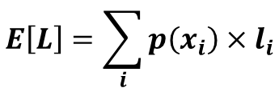


Basics in coding theory
Expected code length
$$E\left[L\right]=\sum_{i}{p\left(x_{i}\right)×l_{i}}$$
Event | P(X) | Code
a | 0.25 | 00
b | 0.25 | 01
c | 0.25 | 10
d | 0.25 | 11
Event | P(X) | Code
a | 0.75 | 00
b | 0.10 | 01
c | 0.10 | 10
d | 0.05 | 11
Event | P(X) | Code
a | 0.75 | 0
b | 0.10 | 10
c | 0.10 | 111
d | 0.05 | 110
$$E\left[L\right]=2$$
$$E\left[L\right]=1.4$$
$$E\left[L\right]=2$$

Slide 19
Index compression
Observation of posting files
Instead of storing docID in posting, we store gap between docIDs, since they are ordered
Zipf’s law again:
The more frequent a word is, the smaller the gaps are
The less frequent a word is, the shorter the posting list is
Heavily biased distribution gives us great opportunity of compression!
Information theory: entropy measures compression difficulty.

Slide 20
Index compression
Solution
Fewer bits to encode small (high frequency) integers
Variable-length coding
Unary: x≥1 is coded as x-1 bits of 1 followed by 0, e.g., 3=> 110; 5=>11110
γ-code: x=> unary code for 1+⎣log x⎦ followed by uniform code for x-2 ^{⎣log x⎦} in ⎣log x⎦ bits, e.g., 3=>101, 5=>11001
δ-code: same as γ-code ,but replace the unary prefix with γ-code. E.g., 3=>1001, 5=>10101

Slide 21
Index compression
Example
Table 1: Index and dictionary compression for Reuters-RCV1. (Manning et al. Introduction to Information Retrieval)
Data structure | Size (MB)
Text collection | 960.0
dictionary | 11.2
Postings, uncompressed | 400.0
Postings γ-coded | 101.0
Compression rate: (101+11.2)/960 = 11.7%

Slide 22
Search within in inverted index
Query processing
Parse query syntax
E.g., Barack AND Obama, orange OR apple
Perform the same processing procedures as on documents to the input query
Tokenization->normalization->stemming->stopwords removal

Slide 23
Search within inverted index
Procedures
Lookup query term in the dictionary
Retrieve the posting lists
Operation
AND: intersect the posting lists
OR: union the posting list
NOT: diff the posting list

Slide 24

Search within inverted index
Example: AND operation
scan the postings
Term1
2
4
8
16
32
64
128
Term2
1
2
3
5
8
13
21
34
Time complexity: $O(\left|L_{1}\right|+|L_{2}|)$
Trick for speed-up: when performing multi-way join, starts from lowest frequency term to highest frequency ones

Slide 25
Phrase query
“computer science”
“He uses his computer to study science problems” is not a match!
We need the phase to be exactly matched in documents
N-grams generally does not work for this
Large dictionary size, how to break long phrase into N-grams?
We need term positions in documents
We can store them in inverted index

Slide 26
Phrase query
Generalized postings matching
Equality condition check with requirement of position pattern between two query terms
e.g., T2.pos-T1.pos = 1 (T1 must be immediately before T2 in any matched document)
Proximity query: |T2.pos-T1.pos| ≤ k
scan the postings
Term1
2
4
8
16
32
64
128
Term2
1
2
3
5
8
13
21
34

Slide 27
More and more things are put into index
Document structure
Title, abstract, body, bullets, anchor
Entity annotation
Being part of a person’s name, location’s name

Slide 28
Spelling correction
Tolerate the misspelled queries
“barck obama” -> “barack obama”
Principles
Of various alternative correct spellings of a misspelled query, choose the nearest one
Of various alternative correct spellings of a misspelled query, choose the most common one

Slide 29
Spelling correction
Proximity between query terms
Edit distance
Minimum number of edit operations required to transform one string to another
Insert, delete, replace
Tricks for speed-up
Fix prefix length (error does not happen on the first letter)
Build character-level inverted index, e.g., for length 3 characters
Consider the layout of a keyboard
E.g., ‘u’ is more likely to be typed as ‘y’ instead of ‘z’

Slide 30
Spelling correction
Proximity between query terms
Query context
“flew form Heathrow” -> “flew from Heathrow”
Solution
Enumerate alternatives for all the query terms
Heuristics must be applied to reduce the search space

Slide 31
Spelling correction
Proximity between query terms
Phonetic similarity
“herman” -> “Hermann”
Solution
Phonetic hashing – similar-sounding terms hash to the same value

Slide 32
What you should know
Inverted index for modern information retrieval
Sorting-based index construction
Index compression
Search in inverted index
Phrase query
Query spelling correction

Slide 33
Today’s reading
Introduction to Information Retrieval
Chapter 2: The term vocabulary and postings lists
Section 2.3, Faster postings list intersection via skip pointers
Section 2.4, Positional postings and phrase queries
Chapter 4: Index construction
Chapter 5: Index compression
Section 5.2, Dictionary compression
Section 5.3, Postings file compression

